Slide 1
An Introduction to Quantum Mechanics through Random Walks
Duncan Wright
University of South Carolina
Department of Mathematics

Slide 2
Quantum Mechanics Dun Wright
Duncan Wright
University of South Carolina
Department of Mathematics

Slide 3
Overview
Classical vs. Quantum Physics
Statistical Mechanics
Classical Random Walk
Formalisms of Quantum Mechanics
Quantum Random Walk
Entropy and More

Slide 4
Classical vs. Quantum
Macroscopic vs. Microscopic
Complete Knowledge vs. Course Graining
Commutative vs. Non-Commutative
Statistical Mechanics
Probability Measures vs. Trace-Class Operators

Slide 5
Performing Experiments
Step 1: Set up the experiment
Choose the system we wish to analyze
Set the initial state of the system
Step 2: Begin the experiment
Allow an external force to change the system
The initial state of the system changes
Step 3: Measure or observe the outcome of the experiment
Determine how the system has changed
Find the final state of the system

Slide 6
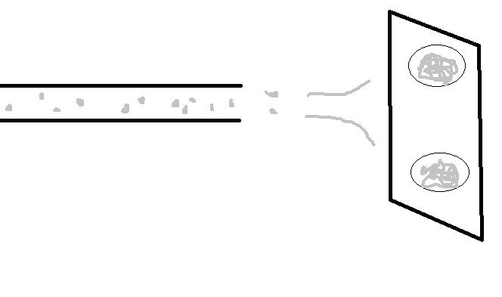
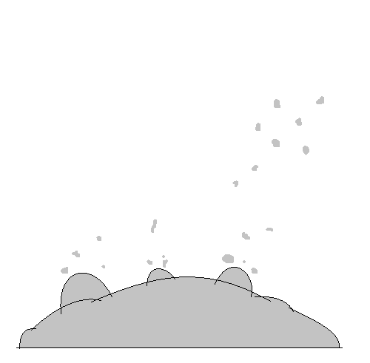
Stern-Gerlach Experiment
+ + + + +
- - - - -

Slide 7
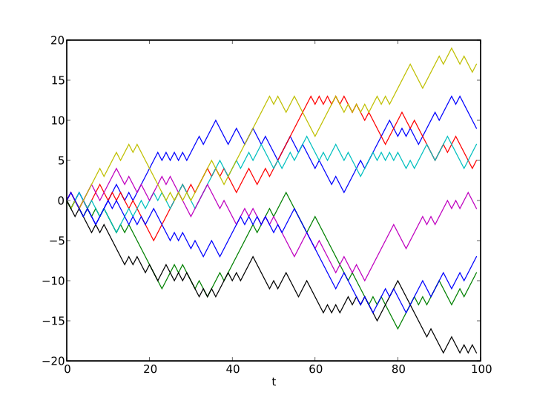
Classical Random Walk
2-Dimensional- Drunk Man’s Walk
1-Dimensional Random Walk
Source: Wikipedia- Random Walk

Slide 8
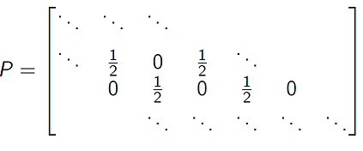
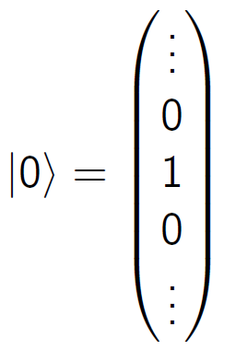
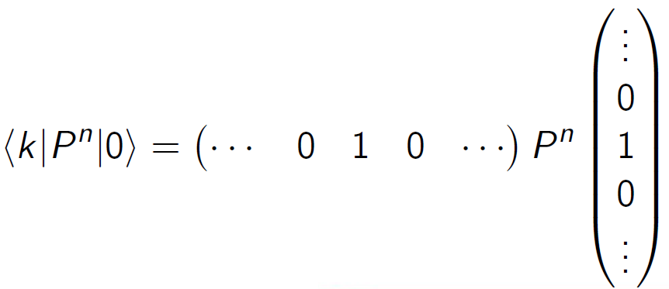
Classical Random Walk
Transition Matrix:
Initial State:
-3 -2 -1 0 1 2 3
n=0 0 0 0 1 0 0 0
n=1 0 0 $1/2$ 0 $1/2$ 0 0
n=2 0 $1/4$ 0 $1/2$ 0 $1/4$ 0
n=3 $1/8$ $0$ $3/8$ 0 $3/8$ 0 $1/8$
Final State:
Transition
Probability:
x
t

Slide 9
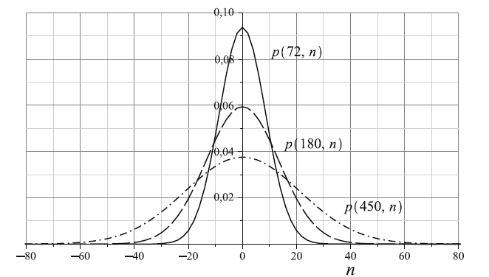
Classical Random Walk
Central Limit Theorem
Source: Renato Portugal (2013): Quantum Walks and Search Algorithms

Slide 10
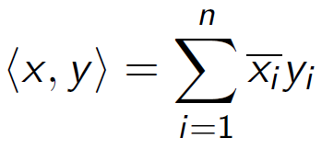
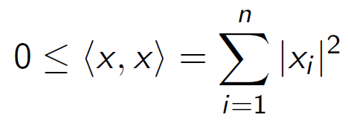
Formalisms of Quantum Mechanics
Def:
Hilbert Space
Ex:
Complete, Inner Product Space
Cauchy sequences converge
Sesquilinear Map
1.
2.
3.

Slide 11
Formalisms of Quantum Mechanics
Hilbert Space
Ex:
Def:
Linear Functionals
“Bra” “Ket”
=
=

Slide 12
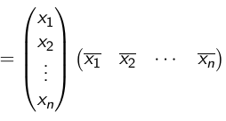
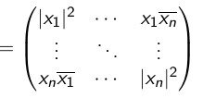
Formalisms of Quantum Mechanics
Hilbert Space
Ex:
Linear Functionals
Def:
Pure
State

Slide 13
From Classical to Quantum
Space:
Probability Distribution
Pure State =
State:
Evolution:
Positive, Trace-Preserving
Operators
Transition Matrix

Slide 14
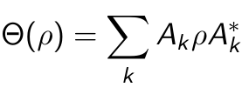
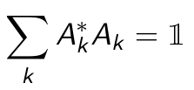
Evolution of a Quantum System
In particular,

Slide 15
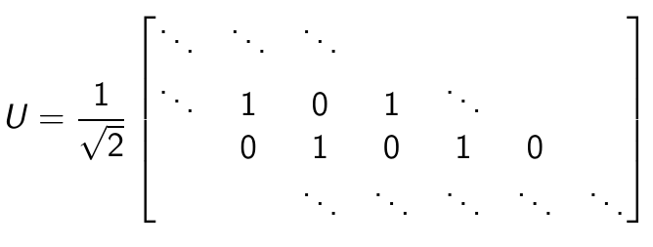
Quantum Random Walk
Evolution:
-3 -2 -1 0 1 2 3
n=0 0 0 0 1 0 0 0
Initial State:
n=1 0 0 $1/2$ 0 $1/2$ 0 0
n=2 0 $1/4$ 0 $1/2$ 0 $1/4$ 0
n=3 $1/8$ $0$ $3/8$ 0 $3/8$ 0 $1/8$
Final State:
Transition
Probability:

Slide 16
Quantum Random Walk
Internal Degrees of Freedom:
$H_{C}$=
with basis
Position Space:
$H_{P}$=
Where the Magic happens:
$H$=
with basis elements
and

Slide 17
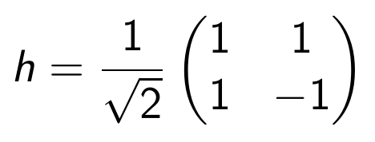
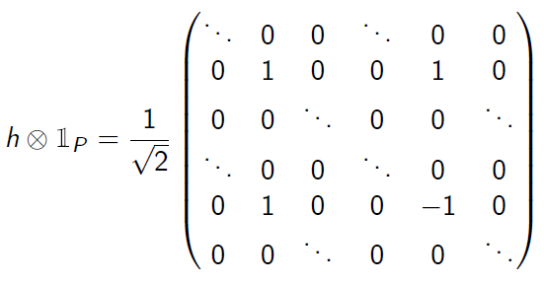
Quantum Random Walk
Coin Space:
Gives equal probability to be in spin up or spin down.

Slide 18
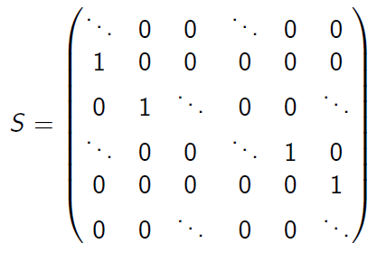
Quantum Random Walk
Shift Operator:
If particle is in spin up, S will shift it right.
If particle is in spin down, S will shift it left.

Slide 19
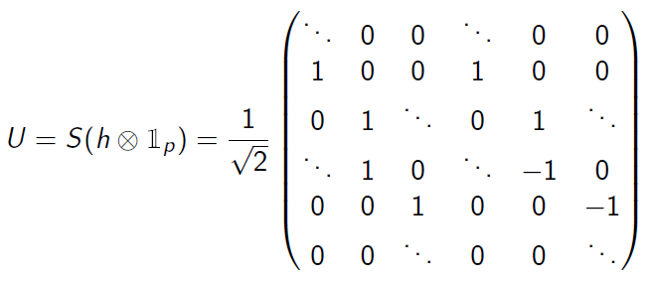
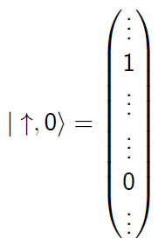
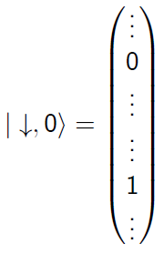
Quantum Random Walk
Unitary Operator:
Now we have options for our initial state even after restricting it to be at the origin.
or

Slide 20
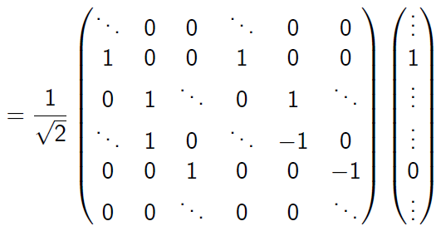
Quantum Random Walk
Initial State:
Evolution:

Slide 21
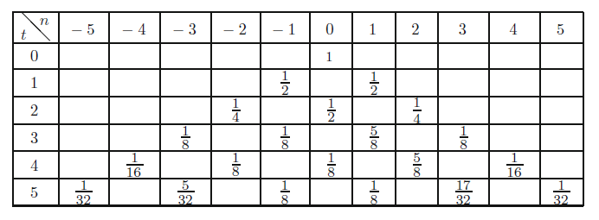
Quantum Random Walk
Initial State:
Source: Renato Portugal (2013): Quantum Walks and Search Algorithms

Slide 22
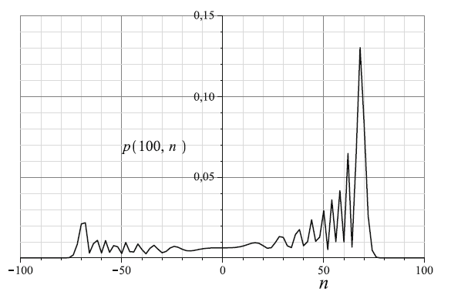
Quantum Random Walk
Initial State:
Source: Renato Portugal (2013): Quantum Walks and Search Algorithms

Slide 23
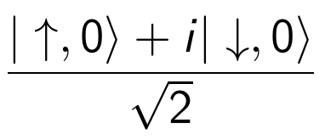
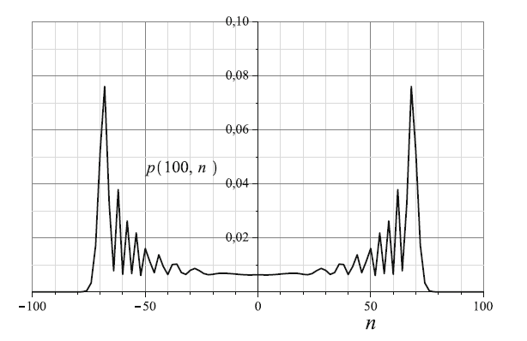
Quantum Random Walk
Initial State:
Source: Renato Portugal (2013): Quantum Walks and Search Algorithms

Slide 24
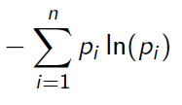
Entropy
We have a classical system whose macrostate is described by the probability measure
$$P=\left(p_{1},p_{2}, …, p_{n}\right) .$$
After measuring the system $N$ times, we expect to see:
1st microstate: $p_{1}N$ times
2nd microstate: $p_{2}N$ times
$n$th microstate: $p_{n}N$ times
$$\frac{1}{N}ln{ }$$
$$N →∞$$

Slide 25
More to Come
Komogorov-Sinai Entropy
Quantum Dynamical Entropy
Open Quantum Random Walks

Slide 26
Thank you!

